Slide 1

2011
HMRC Workshop

Slide 2
Andrew Roberts
Barnett Waddingham LLP
Notes:
2

Slide 3
Chairman for the day
Andrew Roberts
***
Secretarial support
Elaine Turtle / Geoff Buck / Tony Moore
***
Event Organiser
Claire May
Notes:
3

Slide 4
Chairman’s Opening
Housekeeping
  fire alarms and exits
  mobile phones
  location of coffee and lunch breaks
  feedback forms
Notes:
4

Slide 5
Chairman’s Opening
Interactive please!
Brief background to AMPS relationship with HMRC
Members support – sub committee
Notes:
5

Slide 6
Chairman’s Opening
Structure of the day
Notes:
6

Slide 7

Morning Agenda
HMRC Intervention Visits – Karen Secker, MC Trustees
Dealing with rent collection and arrears – Andy Hay and Sharon Sullivan, CB Richard Ellis Ltd
What is residential property? – Mike Norris, MDP Pensions
Coffee
Taxable moveable property & related issues – Michael Smith, AMPS committee
RPSR Audits – Andrew Roberts, Barnett Waddingham LLP
Lunch

Slide 8
Afternoon Agenda
Finance Bill 2011 update – Robert Graves, Rowanmoor Pensions
AMPS update on various HMRC related issues - Michael Smith, AMPS committee
General discussion and participation session – hosted by Michael Smith& Robert Graves
Coffee
Thoughts on pensions post 2011 –Neil MacGillivray, James Hay
Where will scheme pensions under individual trust based schemes fit in? – Tony Moore, AMPS Committee
Open Session – Robert Graves, Rowanmoor Pensions
Chairman's Close – Andrew Roberts, Barnett Waddingham

Slide 9
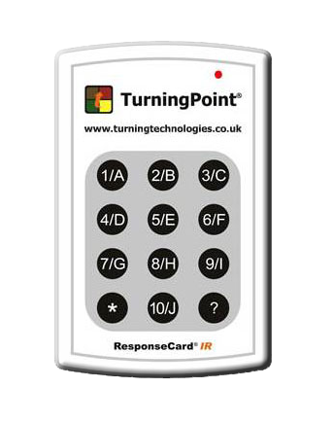
Working with the voting system
Notes:
9

Slide 10
TEST QUESTION?
Which one of these teams is most likely to win the league?
Manchester United
Liverpool
Chelsea
Arsenal
Come on you Spurs!
Notes:
10

Slide 11
QUESTION?
What is your personal role within your firm?
Principal
Technical
Administration
Sales and/or marketing
Other
Notes:
11

Slide 12
Karen Secker
MC Trustees
THE HMRC
INTERVENTION VISIT

Slide 13
      How are you notified of a visit?
      What is the notice period?
      What will you receive from HMRC?
      How long is the visit scheduled to last?
      What will HMRC want to review?
      What topics are covered by the pre-inspection questionnaire?
Notes:
Email received approximately 2 months prior to visit advising appointment to be made.
Telephone conversation with HMRC agreeing date
HMRC send out formal notice and pre-inspection questionnaire
INTERACTIVE QUESTIONS
Have you received any correspondence or calls from HMRC about Relief At Source (RAS) or any other topic? YES/NO
If you have answered Yes, was the call/correspondence about RAS or another topic 1 = RAS
2 = Other topic

Slide 14
      List of all schemes for which the company is responsible
      Membership list for each scheme, including the members’ National Insurance numbers
      If more than one of your companies is involved with your schemes, you should establish with HMRC which company they wish to investigate before sending any information
Notes:
If you have separate companies dealing with SSAS and SIPP administration, HMRC may not have picked this up. You may only need to provide information for one company.

Slide 15
      Address where records and documents are held, including Relief at Source
      Which IT software do you use for your pensions administration and will there be any restrictions to accessibility to HMRC during their visit?
      Are separate paper records kept?

Slide 16
Question
      Do you have processes in place for identifying when the following types of transaction have been made?
      Acquisition of residential property Intellectual property
      Loans to members/connected parties Loan or rental arrears
      Tangible moveable property In-specie contributions
      Intellectual property
      A = YES
      B = NO
      C = DON’T KNOW
Notes:
INTERACTIVE QUESTION
Do you have processes in place for identifying all the above transactions? Yes/No

Slide 17
      Where investments of this type have been made, HMRC will require a brief summary of the systems and processes you have in place to be able to compile Event Reports and Registered Pension Scheme Returns.
      HMRC may ask to see evidence of the processes you have outlined on your pre-inspection questionnaire during the inspection and request details of the schemes which have made these types of investment

Slide 18
Scheme Events
      HMRC will ask you to define the systems and processes you have in place for capturing information required for the Event Report:
      Short service refunds
      Trivial commutation lump sums
      Income drawdown
      Tax free lump sum on pension commencement
      Serious ill-health lump sums
      Lump sum death benefits
      Transfer into pension schemes
      Transfers into QROPS
      Taxed income repayments
      Use of pre A Day protection
      Change of input period
      Unauthorised payments

Slide 19
Relief at Source
      HMRC will require:
      a list of all schemes for which the company is responsible
      the systems and processes you have in place to ensure that the contributions are eligible for tax relief
      confirmation that the claims don’t include transfer-in payments and failed transactions and how you account for these
      a breakdown of under/over claims and explanations of why these have occurred
      Confirmation that full details supporting each claim submitted are retained by you.
Notes:
You have already supplied a list of members and their NI numbers

Slide 20
      . . . . . . . . . and finally,
      HMRC will want a copy of the standard member’s application form/declaration (even if this is downloadable from your
      website)

Slide 21
      Prior to the visit, we received confirmation of HMRC’s estimated time of arrival and the names of the officers who would be attending.
      Four officers, 3 day visit
      Fifth officer joining on day 3

Slide 22
      So, the visit begins !
      We gave HMRC access to all members of staff and all client files
      Major areas of interest for HMRC:
      Transfers to QROPS
      Unquoted shares – connected and not connected
      In specie contributions – property/shares
      Residential property – acquisition and transfers
      Connected party rent arrears
      Relief at Source
      Trivial commutation
Notes:
QROPS transfers – to see BCE 8 calculations, evidence that this would be included on Event Report. Checking that administrator had ensured QROPS on HMRC’s permitted list
Unquoted shares – arm’s length valuation of company, type of shares being acquired. Proof of ownership (share certificate)
In specie contributions – creation of debt, how debt will be satisfied, satisfaction of debt and how we dealt with any under or over contribution
Residential property – do we check Google Earth? How do we ensure we don’t acquire residential property?
Connected party rent arrears – HMRC keen to note how you deal with this, what you systems and processes are and whether you are successful in obtaining arrears
Relief at Source – this is covered later on in depth !
Trivial commutation – they wanted to see calculations, declarations re total pensions and our understanding of how this works

Slide 23
HMRC asked whether they could take copies of documentation of interest to them prior to doing so
The documentation copied was in respect of in specie contributions, unquoted shares, property acquired from connected parties, property with flat above shop, salary sacrifice and property which may have appeared to contain a residential element
The interaction between HMRC and ourselves was very open and honest – first name terms

Slide 24
Summing Up Meeting
The declaration in our contributions form did not meet HMRC’s requirements – there were two words missing, resulting in them advising that RAS had been claimed early on all post A Day contributions (pre A Day members were exempt from this, as the pre A Day declaration was different).
HMRC advised that as RAS had technically been reclaimed early, interest was due on the sums claimed from the date of the claim to date.
We were required to “repair” the declarations on our contributions form. HMRC suggested the methodology for this and so we wrote to relevant members advising them of the new declaration and that this would be the declaration deemed to have been made by them unless they advised us to the contrary by a specified date. We didn’t receive any comments from members and advised HMRC that all cases had been “repaired”.
Notes:
HMRC were keen to point out that we weren’t the only company who had deficient declarations.
INTERACTIVE QUESTION
How confident are you that the declarations contained on your application/contributions documentation are correct?
1= Very
2= Not Very
3= Don’t know

Slide 25
HMRC will check the data you submit on the RPSCOM against the RAS you have claimed and if there are discrepancies, they will ask you for details.
HMRC asked for a copy of our rent collection procedure and associated standard letters/emails
Other than the RAS situation, HMRC were happy with our understanding of their requirements and how we included these in our systems and processes. They advised us that we had been very open and honest and that we had a knowledgeable and well trained team who were doing a good job!

Slide 26
Follow up correspondence
We received a letter from the Interventions Officer who had led the investigation about a month after the visit.
The letter confirmed that HMRC had been impressed by our team’s knowledge and understanding of the business and also HMRC’s requirements in relation to pensions. They loved our “checklists”!
The letter contained an appendix which provided details of further comments and information required by HMRC.
Notes:
We process our administration on a checklist basis, either automated or in paper format. This ensures we don’t omit any part of the procedure and also provides a record for both internal audit purposes and external checking, such as by HMRC.

Slide 27
The appendix contained:
comments on procedures
requests for additional information.
RAS – confirmation that our declaration was deficient and that interest would be chargeable on RAS claimed early. We were asked to provide a summary of the RAS claimed early so that HMRC could calculate interest due. We haven’t yet received further information from HMRC since we supplied this information! This was the only section which contained a timescale – we were invited to change this if it didn’t give us enough time!
Notes:
“Keep an eye out” for contributions made via salary sacrifice and ensure this is dealt with as an employer contribution and that RAS is not claimed.
One SIPP had purchased shares in a limited company – a valuation of the company had been obtained in order to determine the share price. HMRC requested copies of the company’s accounts for the three years preceding the share purchase as they intended to ask the Shares Assets Valuation department to consider the price paid on an “informal” basis. We haven’t received any feedback about this yet!

Slide 28
What impact did HMRC’s visit have on our Company?
It made us check all our documentation and declarations
We revised our procedure on checking contributions made as a result of salary sacrifice
We decided to keep the checklists
Our staff morale increased hugely
Staff motivated to continue to follow procedures
Notes:
RPSM05202020 details the information and declarations to be contained within an application form before a Relief at Source contribution can be made. The RPSM refers to regulation 6 of the Registered Pension Schemes (Relief at Source) Regulations 2005 (SI2005/3448)

Slide 29
Andy Hay, Sharon Sullivan and Adam Baxter
CBRE
Dealing with rent collection and arrears

Slide 30
Credit Control Process
Dealing with rent collection and arrears
Andy Hay, Sharon Sullivan and Adam Baxter
Tuesday 15th March 2011
Notes:
30

Slide 31
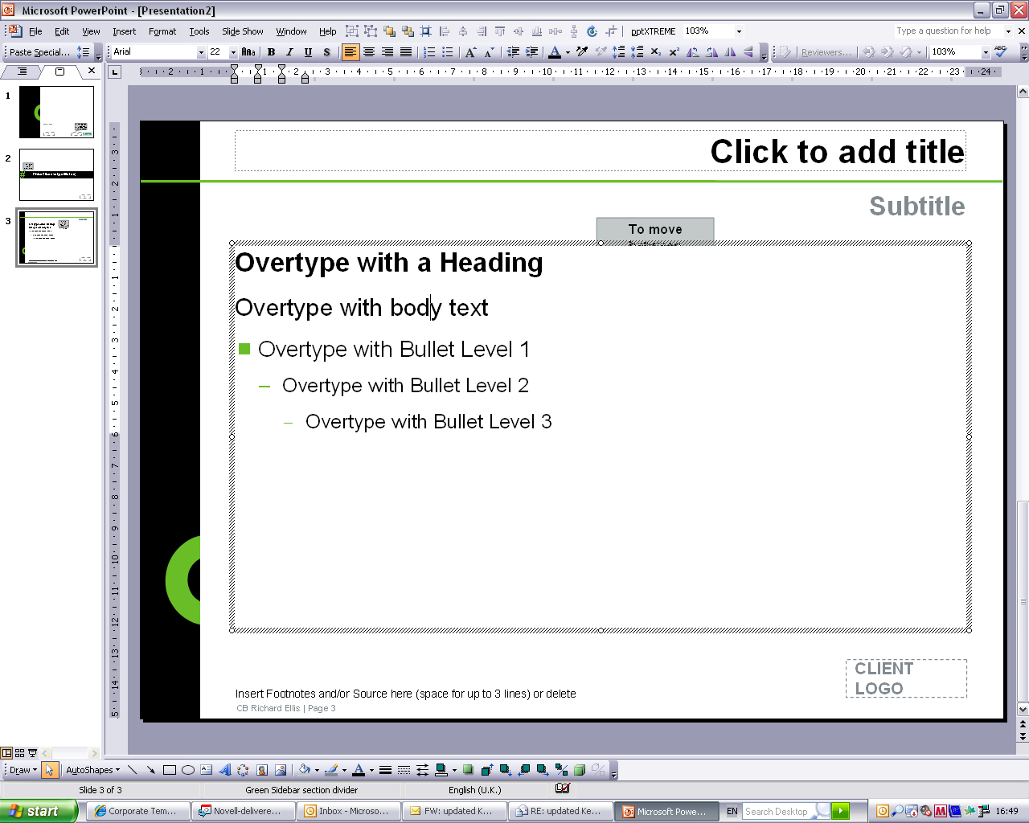
Agenda
Interactive question
About CB Richard Ellis
Our approach to commercial rent collection
Interactive question
Discussion
Notes:
31

Slide 32
Interactive Question
Do you feel your credit control process is commercially robust?
A = Yes
B = No

Slide 33
CB Richard Ellis
Who We Are
CB Richard Ellis is the largest global provider of Real Estate Services
NYSE quoted – market capitalisation c$6 billion
33,600*
Employees
$34.7 Billion
Investment Management Portfolio
Global
$116.2 Billion
Loan Servicing Portfolio
$40.5 Billion
Property Sales
Transaction Value
104,225
Valuation and Advisory Assignments
$56.7 Billion
Property Leasing Transaction Value
  Services
Development
Capital Markets
Agency
Asset Services
Valuation and Advisory

Slide 34
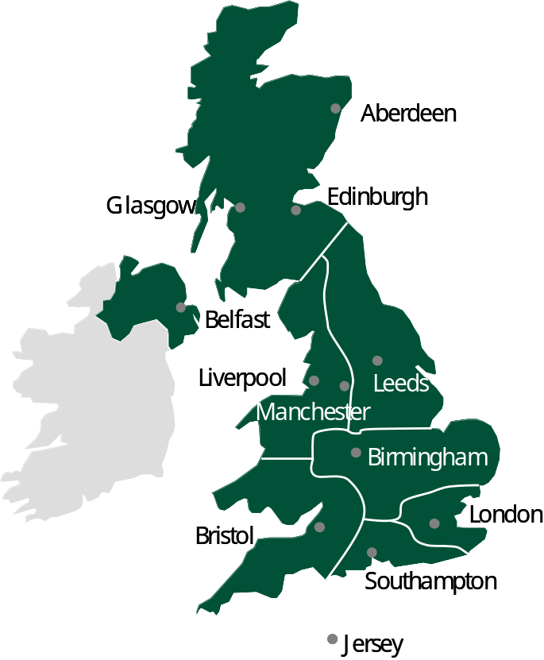

Asset Services
Property Asset Management UK
Over 100 million sq ft under management
£160 million of services procured
4,700 properties managed
13,700 tenants managed
Over £1.5 billion of rent collected each year
350 clients/funds
100 strong client accounting team
100 management surveyors
200 field-based staff

Slide 35

Credit Control
Seeking The Rent

Slide 36

Credit Control Process
Pre Quarter Day
6 weeks before due date Demands issued
3-4 weeks before due date Reminder letters and statements issued
0-2 weeks before due date Telephone calls and emails to tenants
Due date Review of collections to date and targets
By the due date we collect an average of 80% of the rents demanded across all managed properties.
By the due date on our SIPP portfolio, we collect an average of 72%.

Slide 37
Credit Control Process
Post Quarter Day
0-7 days after due date Chasing tenants by telephone/email
7 days after due date 7 Day reminder letter issued to all tenants
Plus 14 days Bailiff / legal action – client instruction
SIPP process Final letter followed by bailiff / legal action
By day 28 we collect an average of 99.12% of the rents demanded across all managed properties.
By day 28 on our SIPP portfolio, we collect an average of 93.98%.

Slide 38
Aged Arrears
Outside The Quarterly Process
Review with Surveyor / Client
Resolve tenant queries swiftly
Consider payment plans
Monitor insolvency situations
Recommendation of bailiff / legal action

Slide 39
Good Practice Summary
Our Recommendations
      Early identification of tenants with cash-flow issues and excuses for non payment
      Building tenant relationships through regular communication
      Dealing with pension members – “It’s my property”
      Taking commercial decisions and not being afraid to instruct bailiffs / solicitors
      Regular review of payment plans
      Ensure that rent s received are swiftly transferred to the SIPP
Notes:
39

Slide 40
Interactive Question
Do you feel your credit control process is commercially robust?
A = Yes
B = No

Slide 41
Who we are
Andy Hay
Managing Director - Property Asset Management
T: 020 7182 3799
M: 07899 066 640
E: Andy.Hay@cbre.com
Sharon Sullivan
Credit Control Manager
T: 0141 228 7225
M: 07983 707 887
E: Sharon.Sullivan@cbre.com
Adam Baxter
Head of SIPP Property Management Team
T: 0113 394 8815
M: 07908 622 119
E: Adam.Baxter@cbre.com

Slide 42
Mike Norris
MDP Administration Services LLP
What is Residential Property?

Slide 43
We will know it when we see it, won’t we?

Slide 44
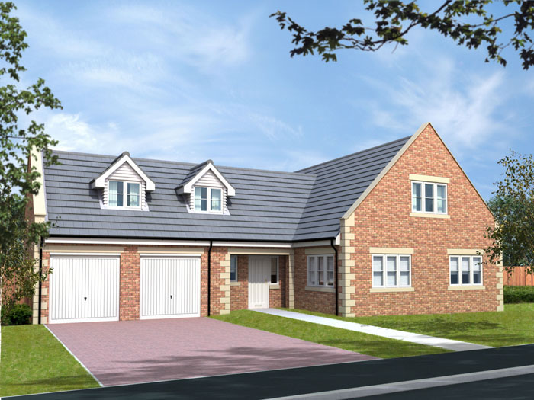

Slide 45
Question –
Does anyone hold residential property in their Pension Funds ?
A = Yes
B = No
C = Don’t Know

Slide 46
But the problem is as Scheme Administrators we do not see the property, we rely on the information supplied to us by our clients and their professionals

Slide 47
So a client calls us and says that he wishes to buy a property and as he is ‘well informed’ he advises us that the property is not residential.

Slide 48
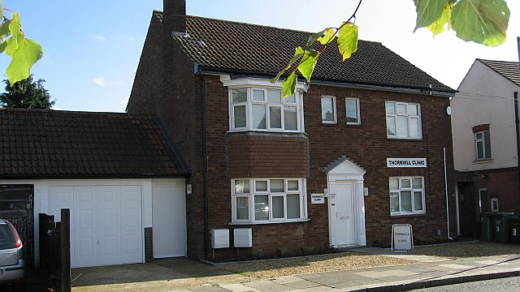

Slide 49
As you can see it looks like a residential property but is it?

Slide 50
This is the main problem we all have.
Sometimes a client will tell us that something is NOT residential and on the face of it he is right but is that correct?

Slide 51
The next picture is a development of offices and shops and has flats at the top let commercially and the seller has advised the client that the purchase is all commercial

Slide 52
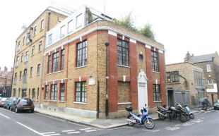

Slide 53
This next slide is a Power Station with development permission to convert to offices, shops and flats.
What is the difference in the 2 properties
Not a lot really except one is being developed and one has been developed

Slide 54
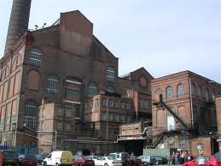

Slide 55
So in the clients eyes there is no difference between the two but we know different don’t we?
Let us consider if some other properties would be acceptable?

Slide 56


Slide 57
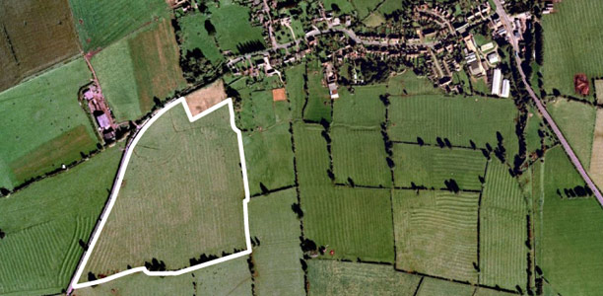

Slide 58
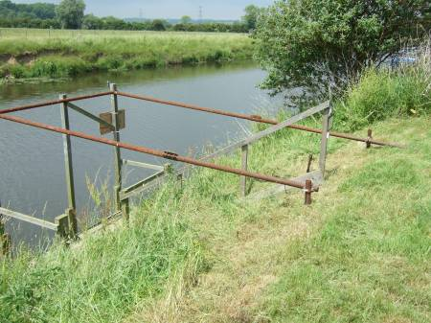

Slide 59
Question –
Does anyone hold land next to a clients property in their Pension Funds?
A = Yes
B = No
C = Don’t Know

Slide 60


Slide 61


Slide 62
Question –
Does anyone hold storm damaged property or property pre December 2005 that cannot be improved and is very difficult to sell?
A = Yes
B = No
C = Don’t Know

Slide 63
Taxable Property Legislation issued in December 2005 killed this one for us

Slide 64


Slide 65
Question –
So would this property be an acceptable investment?
A = Yes
B = No
C = Don’t Know

Slide 66


Slide 67


Slide 68
So as we can see it is clear that the position is not as clear as it could be
What do we need to do or consider?

Slide 69
Has anyone used: -
Land Registry
Google Earth
  Satellite, maps, historical imagery, terrain etc
Internet property sales
Estate Agents’ local knowledge

Slide 70
We have probably used one or two of the various options available to us
Importantly though what does HMRC use?
We know they use Local Authority searches and Google Earth so make sure you consider this as well

Slide 71
I would now like to consider a few other problem areas

Slide 72


Slide 73
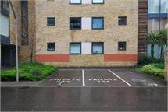

Slide 74
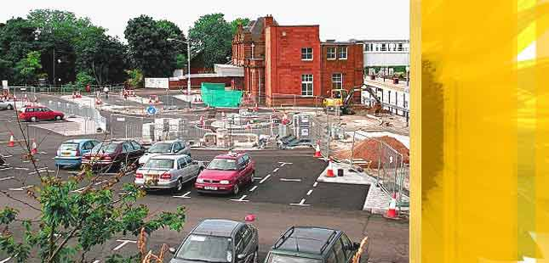

Slide 75
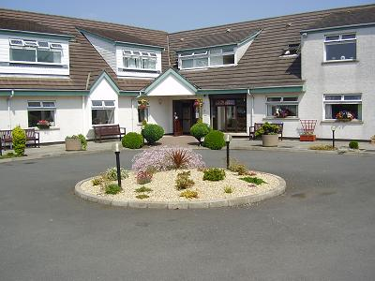

Slide 76


Slide 77
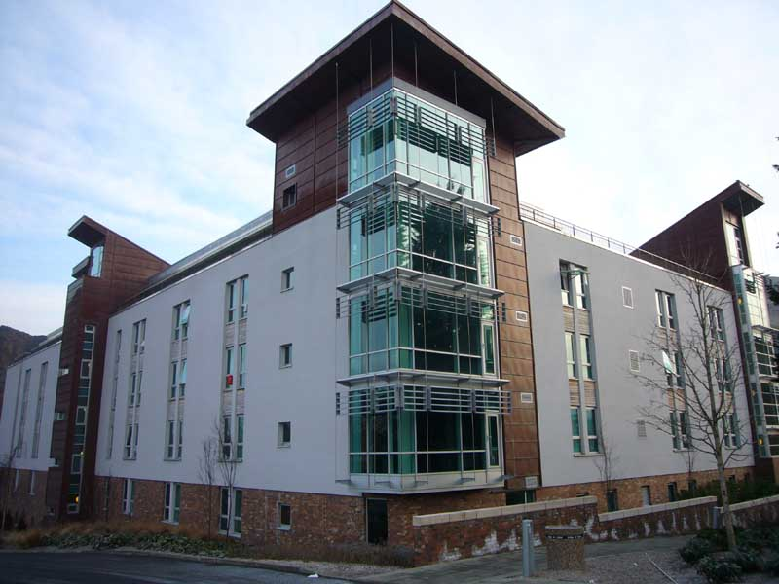

Slide 78
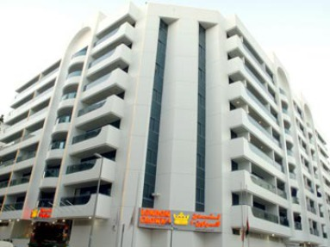

Slide 79
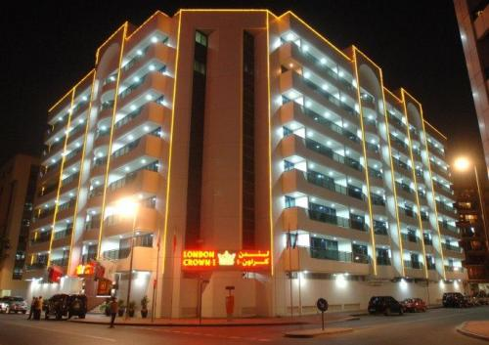

Slide 80
5. Residential Property
5.1 Residential property can be in the UK or elsewhere and is
5.1.1 a building or structure that is used or suitable for use as a dwelling.
5.1.2 any related land that is wholly or partly the garden for the building or structure,
5.1.3 any related land that is wholly or partly grounds for the residential property and which is used or intended for use for a purpose connected with the enjoyment of the building,
5.1.4 any building or structure on any such related land,
5.1.5 in limited situations a hotel, which includes inn, or similar accommodation, will be counted as taxable property though this will only be where it provides accommodation rights such as timeshare. See paragraphs 5.12 to 5.16 below,
5.1.6 a beach hut
5.1.7 any building specified in Regulations as residential property.
5.2 Certain buildings that would otherwise be within the definition of residential property are not to be treated as residential. A building used for any of the following purposes is not residential property
5.2.1 a home or other institution providing residential accommodation for children. This means a dedicated children's home not simply any home that children can live in, for example, a family's house,
5.2.2 a hall of residence for students. This does not include normal houses or flats let to, for example, university students,
5.2.3 a home or other institution providing residential accommodation with personal care for persons in need of personal care by reason of old age, disability, past or present dependence on alcohol or drugs or past or present mental disorder,
5.2.4 a hospital or hospice,
5.2.5 a prison or similar establishment,
5.2.6 any building specified in Regulations as not to be treated as residential property.
5.3 If a building is not currently in use then you need to look back at the last time it was used. If it was last used for one of the non-residential purposes set out in paragraph 5.2 then it is not treated as residential property. If the building has never been used and is more suitable for one of the uses specified in paragraph 5.2 than for any other purpose it is not treated as residential property regardless of their suitability for use as a dwelling.

Slide 81
Parts of buildings
5.4 Building or structure includes part of a building or structure.
5.5 If a building includes a large number of separate flats then these are all treated as separate buildings.
5.6 If a building includes a shop with a wholly separate flat above it is treated as two separate buildings. The flat is a residential property and the shop is a commercial one. A flat is wholly separate if it has a separate entrance and has no inter-connection with other parts (for this purpose a communal hallway is not an inter-connection).
5.7 If a building comprises part which is used for commercial purposes, such as a shop, with an inter-connected residential area, such as a flat, this is one building and the whole will be treated as residential as it is suitable for use as a dwelling. Different parts of a building are inter-connected if they share a common entrance and where you can move from one part to another without moving through common areas.

Slide 82
5.8 When it is necessary to determine such issues as
whether a dwelling comprises the whole of a building or structure or more than one building or only part of a building,
whether land forms part of the gardens or grounds of the building used for a purpose connected with the enjoyment of the building, HMRC will look at the specific facts and circumstances and take a pragmatic and common sense approach.

Slide 83
5.9 For example a detached garage used to house the family car is part of the residential property but merely because a house is on the same area of land as a factory would not make the factory residential property.
5.10 If there is mixed use you should look to establish the primary use. For example.
5.10.1 An ancillary building that is primarily used for non residential purposes, perhaps a farmer's barn but where the farmer occasionally garages his personal car, should be treated as non residential property if the non residential use is the primary use.
5.10.2 Alternatively, if a property is a house that has two rooms used as a dental surgery and waiting room the property will probably be residential property as it is suitable for use as a dwelling.
5.11These issues have a close correlation with issues relevant in dealing with an individual's entitlement to Capital Gains Tax Private Residence Relief. Extensive guidance on all aspects of that relief is provided in the Capital Gains Tax Manual starting at CG64200 which should be consulted for assistance with related issues arising here.

Slide 84
Time share and hotels
5.12 Timeshare accommodation is residential property whether it relates to a separate property, say a self contained flat, or it is in relation to part of a hotel. It covers both rights to use only specific accommodation and rights that whilst attached to specific accommodation permit use of that or any other accommodation. So, for example, it covers both rights to, say, a two week holiday for 25 years in a hotel in Majorca and rights to a two week holiday for 25 years in a flat in Florida that can be exchanged for a holiday in other accommodation anywhere in the world.
5.13 If a pension scheme owns the entirety of a hotel or is a joint owner of all of the hotel then this does not constitute residential property. Hotels, inns and similar accommodation are only residential property where the interest which the person holds directly is part only of the hotel accommodation (that is ownership or joint ownership of a part of the hotel rather than the whole hotel) and is one of the following,
5.13.1 -the person holds part only of the hotel accommodation, or any estate, interest, right or power in or over such a part and as a result, any person has a right to use or occupy that or any other part of the hotel accommodation,
5.13.2 -the person has a right to use, or participate in the arrangements relating to the use of, part only of the hotel accommodation or a description of property to which that part belongs.
5.14 For example this would include a person that buys a 99 year lease on a single hotel room and as a result has the right to stay in the hotel at a reduced or free rate. It does not matter whether the right to stay in the hotel relates only to the specific leased room or to stay in any of the other hotel rooms.
5.15 It will also include the situation where a person has timeshare rights in the hotel, for example the right to stay in the hotel for two weeks every August.
5.16 If the person holds an interest in the entire hotel that will not be residential property. This applies whether the pension scheme owns all of the property itself or if the pension scheme is a joint owner of all of the hotel. In this situation the hotel is treated as commercial property.

Slide 85
6. Property converted or adapted as residential property
6.1 The definition of residential property is a building or structure that is used or suitable for use as a dwelling. It does not therefore apply to property, including land, which is not residential property when the investment regulated pension scheme acquires it. But the building or structure may become residential property whilst owned by the pension scheme as a result of being subsequently subject to development.
6.2 Whilst it is in the course of construction, conversion or adaptation such land and property is not residential property because during that period it is not suitable for use as a dwelling.
6.3 Land and buildings being converted are treated as residential property from the point when they become suitable for use as a dwelling.
6.3.1 In any specific case this point should be determined by taking a common sense approach to the facts and circumstances.
6.3.2 Essentially the question to be answered is:
would a person normally live in that dwelling?
6.3.3 The point at which this occurs will normally be when the works are substantially completed. In the case of UK property this is likely to be when the certificate of habitation is issued.
6.4 A property that is sold before the development or conversion is substantially completed never becomes residential property.

Slide 86
7. Permitted 'Job Related' Residential Property
7.1 Two categories of ‘ job related ‘ residential property will not be taxable property whether held directly or indirectly by the investment regulated pension scheme so these will not be subject to tax charges when held as a scheme investment by an investment regulated pension scheme. These are where the property is within paragraphs 7.2 or 7.3.
7.2 The property is (or, if unoccupied, is to be) occupied by an employee who
7.2.1 Is neither a member of the pension scheme nor connected with such a member,
7.2.2 Is not connected with the employer, and
7.2.3 Is required as a condition of employment to occupy the property.
7.2.4 An example is a caretaker's flat.
7.3 The property is (or, if unoccupied, is to be)
7.3.1 Occupied by a person who is neither a member of the pension scheme nor connected with such a member, and
7.3.2 Used in connection with business premises held as an investment of the pension scheme.
7.3.3 An example is a flat above a shop that is leased from the scheme with the shop, where the flat is occupied by the trader in connection with them operating their trade from the shop.
7.4 Connected person means as defined in section 839 of the Taxes Acts, see RPSM07103180.

Slide 87
Ground Rents
7.5 These are a type of long leasehold and if they are held in relation to residential property they will also be residential property.

Slide 88
3. Investment Regulated Pension Scheme
3.1 There are separate tests for occupational pension schemes and other schemes.
3.2 For non occupational pension schemes an investment regulated pension scheme is one where one or more of its members is or has been able (whether directly or indirectly) to direct, influence or advise on the manner of investments held for the purposes of an arrangement under the scheme relating to the member. It also applies where the condition is satisfied by a person related to the member.
3.3 For occupational pension schemes an investment regulated pension scheme is one where,
3.3.1 it has at least one member who meets the self-direction condition and has fewer than 50 members, or
3.3.2 it has at least 10% of members who meet the self-direction condition.
3.4 The self-direction condition is met if the member is or has been able (whether directly or indirectly) to direct, influence or advise on the manner of investments held for the purposes of the scheme. It also applies where the condition is satisfied by a person related to the member.
3.5 A further category of occupational pension scheme can generate an investment regulated pension scheme. This is where,
3.5.1 the scheme is an occupational pension scheme that is not itself an investment regulated pension scheme,
3.5.2 one or more of its members is or has been able (whether directly or indirectly) to direct, influence or advise on the manner of investments linked to an arrangement under the scheme relating to the member.

Slide 89
3.5.3 In that case that arrangement is treated as if it is an investment regulated pension scheme. This is to prevent large occupational schemes setting up separate sections that allow particular classes of members to direct that their funds are invested in taxable assets.
3.6 For the purposes of paragraph 3.5.2 investments are linked to an arrangement relating to the member if
3.6.1 they are held for the purposes of an arrangement under the pension scheme relating to the member, but
3.6.2 they are so held otherwise than by virtue of a just and reasonable apportionment of the sums and assets held for the purposes of the scheme.
3.6.3 So rather than simply being an apportionment of the collective assets held for all of the scheme these are specific assets held just for the member's arrangement.
3.6.4 Alternatively this will also include a pool of assets held for a limited number of arrangements where those arrangements effectively form a separate section of the scheme designed to allow investments in residential property.
3.7 For each of these three categories of scheme, persons are related to the member if
3.7.1 -the person and the member are connected persons,
3.7.2 -the person acts on behalf of the member or a person connected with a member.
Connected person means as defined in section 839 of the Taxes Acts, see RPSM07103180

Slide 90
17. Indirect Holdings - Which are not subject to tax charges
17.1 Only limited indirect investment in taxable property will not be subject to the tax charges on unauthorised payments set out in paragraphs 19 to 22. This is via genuinely diverse commercial vehicles. Indirect investments held through genuinely diverse commercial vehicles will not be subject to tax charges when held as a scheme investment by an investment regulated pension scheme. There are three categories of genuinely diverse commercial vehicle, UK REITS, Other kinds of vehicle and Trading Concerns. They are described more fully in paragraphs 17.2, 17.3 and 17.4.

Slide 91
17.3.1 Secondly vehicles which meet certain conditions, where the pension scheme, and associates, directly or indirectly own 10% or less and there is no right to have private use of any taxable property. These conditions are set out in paragraphs 17.3.2 to 17.3.20.
17.3.2 The vehicle must meet three conditions.

Slide 92
17.3.3 The first condition is that,
the total value of the assets held directly by the vehicle is at least £1 million, or
the vehicle holds at least three assets directly which are residential property,and in either of these cases no asset held directly by the vehicle which is taxable property has a value which exceeds 40% of the total value of the assets held directly.
17.3.4 In applying paragraph 17.3.3,
assets must be valued in accordance with generally accepted accounting practice,
no account is to be taken of liabilities secured against or otherwise relating to assets (whether generally or specifically), and,
where generally accepted accounting practice offers a choice of valuation between cost basis and fair value, fair value must be used.

Slide 93
17.3.5 The second condition is that if the vehicle is a company,
it is resident in the United Kingdom and is not a close company, or
it is not resident in the United Kingdom and would not be a close company if it were resident in the United Kingdom

Slide 94
17.3.6 The third condition is that it does not have as its main purpose, or one of its main purposes, the direct or indirect holding of an animal(s) used for sporting purposes. This is to recognise that many racehorse syndicates have many members and provide them with certain benefits related to the horse ownership such as attendance at race meetings as an owner with access to the owner's enclosure.

Slide 95
17.3.7 The pension scheme's interest in the vehicle must meet the following conditions.
17.3.8 The first condition is that the pension scheme does not directly or indirectly hold an interest in the vehicle for the purposes of enabling a member of the pension scheme or a connected person of a member to occupy or use the property.
17.3.9 The second condition is that the pension scheme meets either the condition in 17.3.10 or 17.3.11.
17.3.10 This condition is that the pension scheme is an occupational pension scheme and the pension scheme together with any associated person, see 17.3.16, does not hold directly or indirectly an interest in the vehicle that exceeds any one of the limits in paragraph 17.3.12.
17.3.11 This condition is that the pension scheme is not an occupational pension scheme and no arrangement under the pension scheme together with any associated person, see 17.3.16, holds directly or indirectly an interest in the vehicle that exceeds any one of the limits in paragraph 17.3.12.

Slide 96
17.3.12 The limits are,
10% or more of the share capital or issued share capital of the vehicle,
10% or more of the voting rights in the vehicle,
a right to receive 10% or more of the income of the vehicle,
such an interest in the vehicle as gives an entitlement to 10% or more of the amounts distributed on a distribution in relation to the vehicle,
such an interest in the vehicle as gives an entitlement to 10% or more of the assets of the vehicle on a winding up or in any other circumstances.
Such an interest in the vehicle as gives rise to income and gains derived from a specific property.
17.3.13 These limits apply to indirect holdings of a vehicle as well. So if a pension scheme holds 50% of company A which in turn owns 15% of company B then the pension schemes interest in company B will be 7.5%. The indirect holding in company B will therefore be less than 10%.

Slide 97
http://www.hmrc.gov.uk/pensionschemes/taxable-property-guidance.htm#17

Slide 98
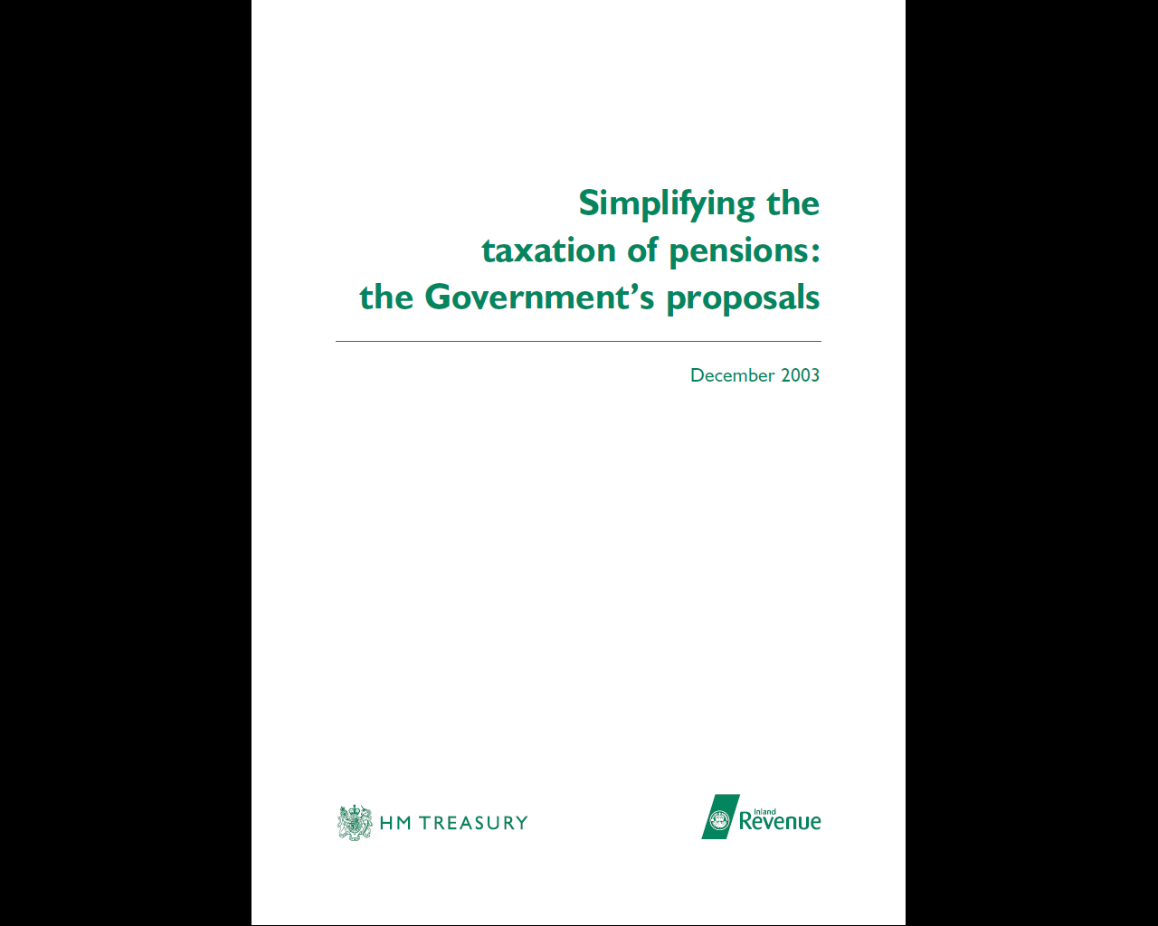

Slide 99
Coffee
served in the
St James 2 Room

Slide 100
Michael Smith
AMPS Committee
Tangible Moveable Property

Slide 101
Discussion Points
Tangible Moveable Property
  Guidance
  Case law
  HMRC stance
  Examples
  Your experiences and thoughts
Indirect interest in TMP and the £6,000 exemption

Slide 102
Tangible Moveable Property – What does the legislation say?
FA2004 Schedule 29A : PART 2 TAXABLE PROPERTY
Taxable property
6 For the purposes of the taxable property provisions property is taxable property if -
(a) it is residential property (see paragraphs 7 to 10), or
(b) it is tangible moveable property (but subject to paragraph 11).
….............
Tangible moveable property
11 - (1) The Treasury may by order provide that, for the purposes of the taxable property provisions, any specified description of tangible moveable property is treated as not being taxable property.

Slide 103
Tangible Moveable Property – What does the legislation say? (Continued)
The Investment-regulated Pension Schemes (Exception of Tangible Moveable Property) Order 2006 (SI 2006 No1959)
Exclusions from tangible moveable property
2.The following property shall not be regarded as taxable property for the purposes of the taxable property provisions (within the meaning in paragraph 1(3) of Schedule 29A to the Finance Act 2004)—
(a) gold bullion (that is, gold of a purity not less than 995 thousandths, which is in the form of a bar, or of a wafer, of a weight accepted by the bullion markets);
(b) any item of tangible moveable property (whose market value does not exceed £6,000)—
(i) held by a vehicle (within the meaning in paragraph 20(2) of Schedule 29A to the Finance Act 2004) solely for the purposes of the administration or management of the vehicle;
(ii) in which the relevant investment-regulated pension scheme does not hold an interest directly; and
(iii) where a member of the pension scheme or a person connected with such a member does not occupy or use, or have any right to occupy or use, the property.

Slide 104
TMP – What does RPSM say?
RPSM07109120 – Technical pages: Investments: Taxable property: Meaning of taxable property: Tangible moveable property
These are things that you can touch and move. Examples are art, antiques, jewellery, fine wine, boats, classic and vintage cars, stamp collections, rare books.
Assets used for the purpose of administration or management of the scheme will not be subject to the tax charges unless, exceptionally, they are held for the purpose of an arrangement relating to a member of the scheme.
See for details of a similar provision relating to indirect holdings in vehicles that possess assets used solely for the purposes of administration or management of a vehicle.
Certain tangible movable property that is specified in Regulations will not be taxable property so will not be subject to tax charges when held as a scheme investment by an investment regulated pension scheme. Such as gold bullion see below and also see .
Any specified items will be of a type that is normally held as investments and do not provide any possibility of personal use. Investment grade gold bullion has been specified. The definition of investment grade gold is gold of a purity not less than 995 thousandths that is in a form of a bar or a wafer, of a weight accepted by the bullion markets.
Any Regulations that may be made to allow certain tangible moveable property to be held and not count as taxable property may have effect from an earlier date to that on which the Regulation is made

Slide 105
TMP – What does the Capital Gains Manual say?
CG76553 - Chattels: introduction: moveable
There is no specific meaning for the term `moveable' in the Capital Gains Tax legislation. In general law, there are specific rules which determine whether an asset is moveable or has become fixed.
If an asset has not become part of the land or any building to which it is attached, then it retains its separate identity. If, however, it is permanently or semi-permanently attached to the land or any building, it is regarded as part of that land or building.
In a Capital Gains Tax context, you should regard the question as one of fact. Can the asset be moved easily and without damaging its surroundings
Small items of plant or other easily moved items will satisfy the test.

Slide 106
Tangible Moveable Property – Roll-over Relief – what the CG Manual says?
CGT Roll-over Relief on disposals of certain listed assets (TCGA92/S152+)(CG60250c+).
Certain Fixed plant & machinery are qualifying assets (CG60410)
Not defined. Four basic tests. Three relevant to issue of 'fixed':
  Intention to hold in a particular location indefinitely
  Is location in a particular site essential to its function?
  Consider the nature of the object and means of permanent fixing (CG60960).

Slide 107
Tangible Moveable Property – Roll-over Relief – what the CG Manual says? (Continued)
Washing machines in a laundrette are deemed 'fixed' here. Shelves, counters etc in a shop are not (moved easily to change layout).
If take this interpretation quite generous. HMRC clearly don't.
Manual distinguishes between fixed plant and machinery which forms part of a building and those that don't. CG60960-
“If it is clear that an item of fixed plant or machinery has become part of a building etc it should be treated as an addition to the building. The question is to be determined by the size and nature of the item in question, how, if at all, it has become attached to the building and how easily it could be removed without damaging the fabric of the building”.

Slide 108
TMP and Plant & Machinery – HMRC line
Emphasis on general case law fixed vs moveable.
Weight not a deciding factor.
Potential for personal benefit not a deciding factor.
Two main tests they'd apply:
  Degree of affixation; and
  Reason fixed to the building - to enhance the building’s value or has just been fixed so the item can be used?
Last test more important. Depends facts of the case.

Slide 109
Tangible Moveable Property – HMRC line
If item capable of being disassembled in isolation, however difficult, it would be TMP.
Number of cases on the go. Cannot comment until finalised.

Slide 110
Tangible Moveable Property – What are these law cases and what did they say?
Holland vs Hodgson (1872)
  Sets out the two tests HMRC apply as to whether part of land / buildings
  If only attached due to weight, not part of the land (unless intended to form part of land)
  If attached, must be good reason to deem a chattel
Berkeley vs Poulett (1976)
  Expanded on Holland vs Hodgson
  Objects can still be chattels even though fixed to building
  Principle of looking at why fixed (does it enhance land?)

Slide 111
Tangible Moveable Property – What are these law cases and what did they say?
Elitestone vs Morris (1997):
  Principles of whether moving asset will damage the building if removed
Botham vs TSB Plc (1997):
  Looked at everyday household items and determined whether fixtures or chattels

Slide 112

Is Beachy Head Lighthouse TMP?!
A = Yes
B = No

Slide 113
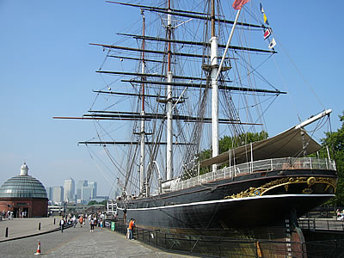
Is the Cutty Sark TMP?!
A = Yes
B = No
C = Not sure

Slide 114

Is a wind turbine TMP?
A = Yes
B = No
C = Depends
D = Not sure

Slide 115

Is a solar panel TMP?
A = Yes
B = No
C = Depends
D = Not sure

Slide 116

Are trees TMP?
A = Yes
B = No
C = Depends
D = Not sure

Slide 117

Are carpets TMP?
A = Yes
B = No
C = Depends
D = Not sure

Slide 118
Tangible Moveable Property – Issues and going forward
How much of a problem? How many cases?
Consistency of line by HMRC?
Line taken inconsistent with CG Manual.
Complex. Consult lawyer every time! Is it worth the risk?
Timing - when do you acquire an interest?
Terms of the lease indicate not part of the land?
Implications for existing commercial property (unwittingly own TMP)?

Slide 119
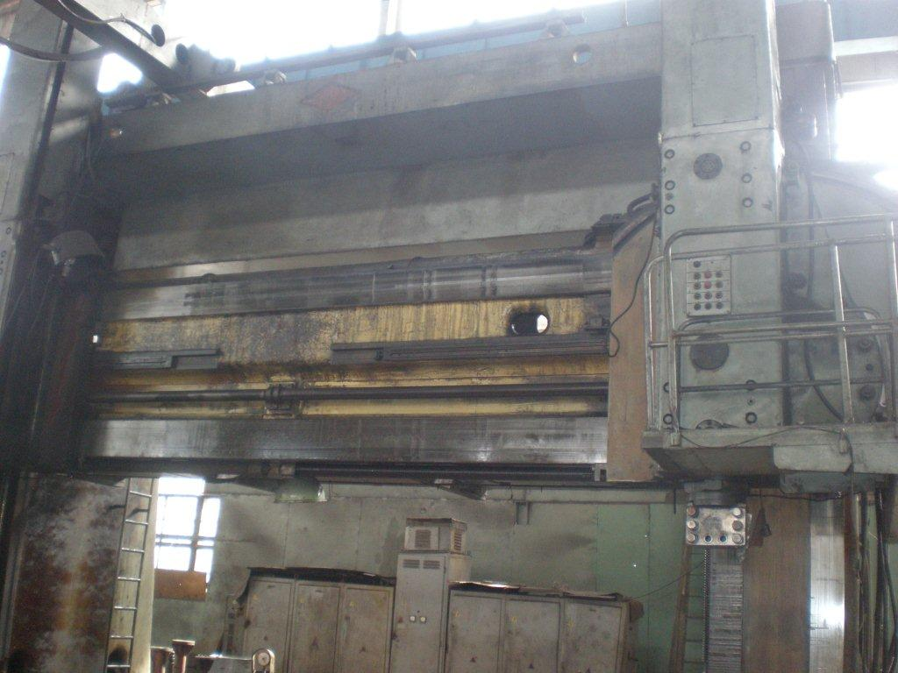
Have you allowed heavy plant and machinery investments in your SIPP / SSAS ?
A = Yes
B = No

Slide 120
Do you have cases where HMRC are treating heavy plant and machinery as TMP?
A = Yes
B = No

Slide 121
What is your most unusual TMP investment request?

Slide 122
Unquoted shares: Limitation of exemption for indirect interest in TMP
Raised Feb 2010 Q&A.
Issue where invest in a trading company that is not a GDCV.
To be exempt, the item must be used ‘solely’ for administration / management purposes. It cannot be held for the purposes of the trade.
If there is mixed use, then it is not held ‘solely’ for administration purposes, and so is not exempt even if under £6,000 in value.
What is your experiences with HMRC on this issue?

Slide 123
Do you allow unquoted shares in a trading company where not a GDCV?
A = Yes
B = No (but allow unquoted shares)
C = No (do not allow unquoted shares at all)

Slide 124
Do you have cases where HMRC have pursued charges in this circumstance?
A = Yes
B = No

Slide 125
Andrew Roberts
Barnett Waddingham LLP
HMRC RPSR Audits

Slide 126
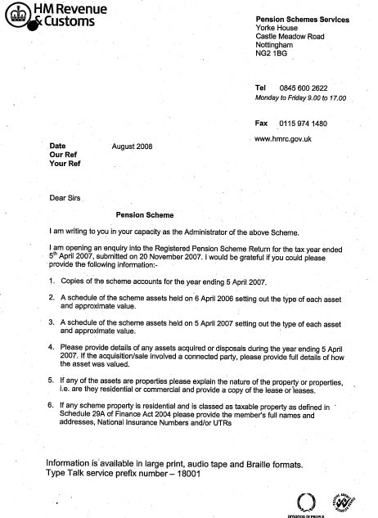
HMRC RPSR Audits
Background
Initial Enquiries
Digging Deeper

Slide 127
Background
40,000 RPSRs were issued for 2006/07
100% (?) of “Investment Regulated Schemes” were targeted, plus larger schemes
At 2008 AMPS Open Meeting, HMRC said that they would apply a risk-based approach to auditing RPSRs, once trends had emerged
SIPPs have been asked - on a triennial basis?

Slide 128
Background
For SIPP only: Have you had an audit into you RPSR?
A: Yes
B: No

Slide 129
Background
For SSAS only: Roughly what percentage of schemes have been selected for RPSR audits?
A: None at all
B: 0 – 5%
C: 5 - 10%
D: More than 10%

Slide 130

Initial Enquiries (1)
Scheme accounts for the year
List of assets at beginning of year
List of assets at end of year

Slide 131

Initial Enquiries (2)
Details of assets acquired
Details of disposals
Evidence of transaction values if connected

Slide 132

Initial Enquiries (3)
Details of property assets, including copy leases
Rental arrears position – action being taken
Details of any scheme borrowing, including fund value at date of borrowing

Slide 133
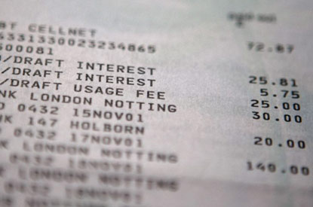
Initial Enquiries (4)
Details of loans including copy loan agreements
Copy of loan security documentation
Loan arrears position – action being taken

Slide 134

Initial Enquiries (5)
Shares - quoted or unquoted
If shares in sponsoring company:
  Fund value at date of purchase
  Number of shares and price per share
  Total number of shares held in that company by scheme
  Name of vendor
  Independent valuation, if unquoted

Slide 135
Digging Deeper
Has HMRC raised any meaningful tax assessment as a result of an audit?
A: Yes
B: No

Slide 136
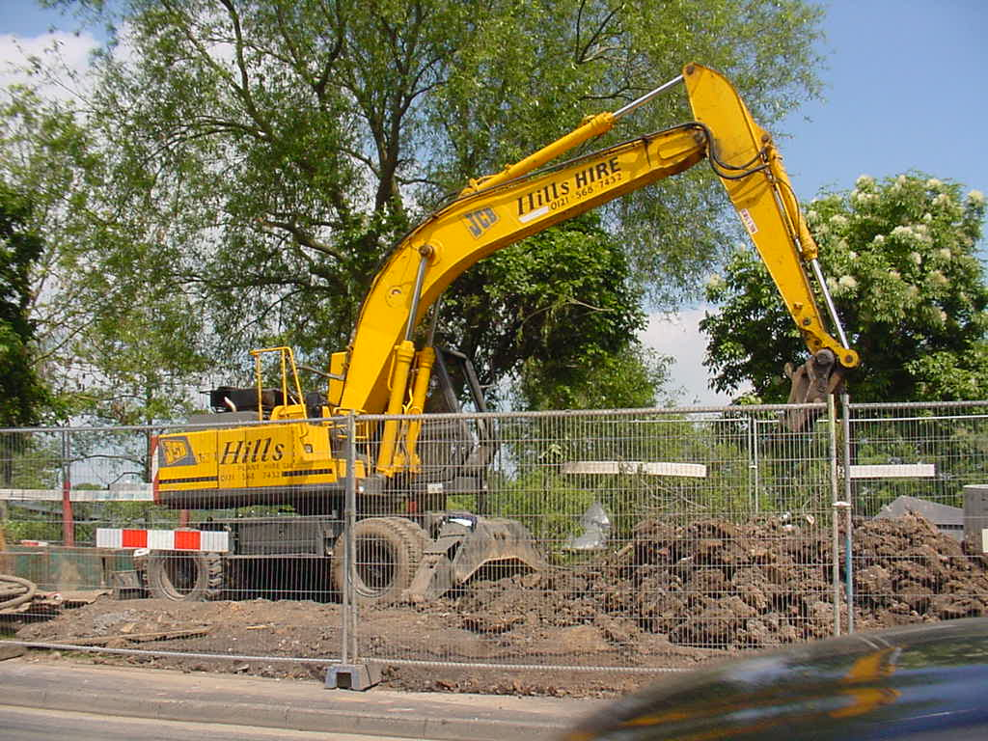
Digging Deeper
Bank Statements
Loans
Property

Slide 137
Bank Statements (1)
Copies of all bank statement for year
Evidence that cash figures on RPSR are correct, and query if don’t tally with last year
Cash held at brokers
Query transactions (including bank charges)

Slide 138
Bank Statements (2)
“HMRC said the scheme had been selected for an enquiry but there was no reference to the RPSRs. It was a cash only scheme and a letter answering a number of basic questions was all that was needed.”

Slide 139
Loans (1)
Copies of loan agreements advanced pre A Day that were still in place post A Day
Copy of bank statement showing whether loan was advanced pre or post Day (in borderline case)
Evidence that the pre A Day loans were reported

Slide 140
Loans (2)
Checking connection of relevant parties
Checking value of security
Land Registry records checked to confirm security position and follow up query when more than one charge was discovered

Slide 141
Loans (3)
Confirmation of whether connected company in receipt of scheme loan has ever participated in scheme, including copies of documentation
Confirmation of amount owed by sponsoring employer to scheme in respect of all loans, together with value of scheme assets, at the date that a further loan to employer was advanced

Slide 142
Loans (4)
“Loans backed by security over portfolio of art and antiques appear to be not a problem - although District Valuer still to investigate the valuations.”

Slide 143
Property
Copies of valuations (when involving connected parties)
Wanted copy lease for small (i.e. £1,000 - £2,000 pa) property leased back to company, even though solicitor advised not worth doing a lease for that

Slide 144
Job Related Property
Name and NINO for occupant
Confirmation that not a member of the scheme
Confirmation that not connected to a scheme member
Copy of employment contract, to demonstrate occupancy was condition of employment

Slide 145
Phased Drawdown
“[HMRC] kept going on about phased drawdown being an unauthorised payment..........a twelve month window opened and had shut by the time the second tranche was drawn......... they just couldn’t get the concept - I had to spell it out step by step, and eventually they withdrew the claim.”

Slide 146
Final Thoughts
For SSAS only: If you have had any concluded RPSR audits, how long on average have the audits taken?
A: Up to 3 months
B: Up to 6 months
C: Up to 12 months
D: Longer than 12 months / still ongoing

Slide 147
Final Thoughts
Do you think HMRC are generally selecting schemes that are higher risk?
A: Yes
B: No

Slide 148
Lunch
served in the
St James 2 Room

Slide 149
Robert Graves
Rowanmoor Pensions
Finance Bill 2011 Update

Slide 150
Issue 1: Reduction in PCLS
LTA = £1.8m
Those with Enhanced or Primary Protection will not be affected by the reduction in the LTA!
LTA = £1.5m
Notes:
150

Slide 151
Member has Enhanced or Primary Protection but NO Lump Sum Protection
Max PCLS Calc = LTA x 25%
LTA = £1.8m
Max PCLS: £1.8m x 25% = £450k
LTA = £1.5m
Applies for Fixed Protection
Max PCLS: £1.5m x 25% = £375k
Applies for Enhanced / Primary Protection
- £75k

Slide 152
Fund = £3m
Partial Crystallisation PCLS Calculation
Pre 2012
Vests £1.5m
Fund £1.5m x 25% = £375k
Used 83% (1.5/1.8) of ‘available portion of member’s lump sum allowance’
Post 2012
Vests £1.5m
Available portion of member’s lump sum allowance = 17% (100% - 83%)
LTA of £1.5m x 17% x 25% = PCLS of £63,750
- £11,250

Slide 153
Intentional or an Oversight?
AMPS highlighted point in October consultation feedback
Contrary to commitment that a reduction in the LTA will not have a retrospective impact
HMRC state in their FAQs if you have EP or PP you will not be affected by reduction in LTA!
Watch this space

Slide 154
Issue 2: Partial Crystallisation Roll Up
Those with Primary Protection or Lifetime Allowance Enhancement Factors
Pre 2012
Vests £900k
£900k represents
50% of LTA of £1.8m
How much of the LTA has been used up?
£1.8m less 50% of £1.8m = £900K
£1.8m less 50% of £1.5m = £750k
If b) a further £150k escapes Excess LTA charge
Post 2012
Vests £2.7m

Slide 155
Issue 3: Charity Lump Sum Death Benefits
Before 6th April 2011
Age
0
55
75
?
Uncrystallised
Pension Fund
Alternatively
Secured Pension
Unsecured Pension
Lump Sum
– “Normally” Tax Free
Lump Sum
- 35% Tax
Charity Lump Sum – Tax Free

Slide 156
After 5th April 2011
Lump Sum -55% Tax
Or
Charity -55% Tax ?!
Age
0
55
75
?
Uncrystallised
Pension Fund
Drawdown
Lump Sum
- Tax Free
Lump Sum Or Charity Lump Sum
- 55% Tax - Tax Free

Slide 157
Issue 4: Two Year Payment Rule
After 5th April 2011
Pay Within 2yrs ?!
Lump Sum -55% Tax
Or
Charity -55% Tax ?!
Age
0
55
75
?
Uncrystallised
Pension Fund
Drawdown
Lump Sum
- Tax Free
Lump Sum Or Charity Lump Sum
- 55% Tax - Tax Free
Pay Within 2yrs
No Time Limit

Slide 158
Issue 5: IHT on Death Benefits
Before 6th April 2011
Lump Sum Death Benefits from uncrystallised
funds are paid free of IHT
BLANK
“Normally” “Usually” “In general”
“As a rule” “On the whole” “By and large” “Generally” “Typically” “Customarily” “Ordinarily” “In the main” “More often than not”

Slide 159
Fryer v HMRC
Gist of the case:
Personal pension member diagnosed terminally ill – aged 58
Pension provider gave option to draw benefits at normal retirement – age 60
Member ignored option – fund remained uncrystallised
Member dies age 62 – lump sum paid to beneficiaries
HMRC successfully claim some IHT – failure to exercise option meant death estate diminished

Slide 160

Fryer case put the HMRC Cat amongst the Adviser Pigeons
Finance Bill clarity – No IHT
NB: Making excessive contributions following terminal illness diagnoses could still be treated as tax avoidance

Slide 161
Issue 6: Non Transfer of 120% GAD
Triggers review at next plan anniversary
Transfer plan to new provider
6/4/2011
6/4/2012
6/4/2013
6/4/2014
6/4/2015
6/4/2016
Yr 1
Drawdown Plan.
120% GAD
Yr 3
Drawdown Review.
100% GAD
Yr 6
Drawdown Review.
100% GAD

Slide 162
Inconsistent Approach
HMRC rationale appears to be ‘it is the member’s choice to transfer’
Currently 5 yr reference period retained on transfer
FSA TCF Customer outcome 6: Consumers do not face unreasonable post-sale barriers imposed by firms to change product, switch provider, submit a claim or make a complaint.
AMPS successful campaign allowing transfer in USP below Normal Minimum Pension Age (NMPA)
New legislation allows retention of 120% GAD until end of 5 yr reference period on additional fund designations to drawdown (Basis amount is recalculated though)

Slide 163
Additional Designation to Drawdown
Additional Drawdown
Designation
Triggers immediate recalc
6/4/2011
6/4/2012
6/4/2013
6/4/2014
6/4/2015
6/4/2016
Yr 1
Drawdown Plan.
120% GAD
Calc new Basis amount based on:
New total fund
New GAD / Gilt rates
But can still apply 120% to new Basis amount.
Yr 6
Drawdown Review.
100% GAD

Slide 164
Issue 7: Lack of amalgamation
Transfer
Single Arrangement Model
£
£
£
£
£
6/4/2007
6/4/2008
6/4/2009
6/4/2010
6/4/2011
6/4/2012
USP 1
USP 2
USP 3
USP 4
Year 6
Review.
Original reference period retained

Slide 165
Issue 7: Lack of amalgamation
Transfer
Multiple Arrangement Model
£
£
£
£
£
£
£
£
6/4/2007
6/4/2008
6/4/2009
6/4/2010
6/4/2011
6/4/2012
USP 1
USP 2
USP 3
USP 4
Year 6
Review.
Original reference period retained

Slide 166
Issue 7: Lack of amalgamation
Age 75
Currently arrangements can be amalgamated at age 75
Multiple Arrangement Model
£
£
£
Transfer
£
£
6/4/2010
6/4/2011
6/4/2012
6/4/2013
6/4/2014
6/4/2015

Slide 167
Issue 7: Lack of amalgamation
Age 75
New rules will not give this opportunity to amalgamate
Multiple Arrangement Model
£
£
£
£
Transfer
£
£
£
£
6/4/2010
6/4/2011
6/4/2012
6/4/2013
6/4/2014
6/4/2015
Each arrangement will be reviewed on each of their anniversaries

Slide 168
Carry Forward – Example 1
Conts paid in last three years were:
Tax Year Amount C/F Total
08/09 £80,000 £ Nil £ Nil
09/10 £40,000 £10,000 £10,000
10/11 £30,000 £20,000 £30,000
Carry forward would be £30,000

Slide 169
Carry Forward – Example 2
Same Conts - Different order
Tax Year Amount C/F Total
08/09 £30,000 £20,000 £20,000
09/10 £80,000 -£30,000 £ Nil
10/11 £40,000 £10,000 £10,000
Carry forward would be £10,000

Slide 170
Carry Forward – Example 3
Shuffle the contributions again
Tax Year Amount C/F Total
08/09 £40,000 £10,000 £10,000
09/10 £30,000 £20,000 £30,000
10/11 £80,000 -£30,000 £ Nil
Carry forward would be £ Nil

Slide 171
Michael Smith
AMPS Committee
Discussion on other HMRC Issues

Slide 172
Rise in NMPA to 55 – HMRC Pension Schemes Newsletter 44
Change in interpretation.
Test at point of first payment, not entitlement.
Test pension and PCLS separately.
Issue of those 50-55 in April 2010 vesting and relying on earlier Newsletter 38.
Not pursuing unauthorised payment charges, but Newsletter does not cover all scenarios.

Slide 173
Rise in NMPA to 55 – HMRC Pension Schemes Newsletter 44
Pension Schemes Newsletter 44 says......
"HMRC is aware that some scheme administrators and members have acted in reliance on that Newsletter in deciding to draw their pension before 6 April 2010 from an age of more than 50 but less than 55. In such cases, where the first pension payment does not occur until after 5 April 2010, the prevailing NMPA of 55 in fact applies.
Nevertheless, HMRC accepts that in these circumstances people and schemes should not incur an unauthorised payments tax charge in respect of any payments of that pension made before age 55 is reached."

Slide 174
Rise in NMPA to 55 – HMRC Pension Schemes Newsletter 44
What about PCLS payments after 5th April 2010? (linked frozen NMPA of 50 based on Newsletter 38).
Issue where (first) payment not occurred by publication of Newsletter 44?
What about those vested well before 5th April 2010 issues and taken nil income since? If 55, can they start taking payments?
Issue where transferring in drawdown and not taken any payment.

Slide 175

Question: How many under 55 cases do you think you have where PCLS paid after 5th April 2010?
A: None
B: 1 to 3
C: 3 to 5
D: More than 5

Slide 176
Transfer between schemes and borrowing
HMRC still maintaining need individual clearance.
Experience of firms from help desk is that do not need to do this provided the lender and amount outstanding the same.
Is this still the case?
What are the principles HMRC are applying?

Slide 177
Joint property ownership and borrowing issues
How are you dealing with cases where over 50% borrowing in joint ownership cases and one wants out?
How big an issue is this?

Slide 178
Relief at Source : issues HMRC are challenging
What issues are HMRC challenging?
Member declarations?
Issues with In-specie contributions?
Issues with making reports?

Slide 179
Scheme Sanction Charges (Pensions Newsletter 44)
HMRC not assessed SSC yet for 2006/07 +.
Applying 25% deduction, but interest from 31st January end tax year UP occurred.
Harsh. No assessments or process (and does Reg 4 of SI2005/3454 (A&A Regs) required an assessment before can pay?).
HMRC say no discretion over the due date of interest. Set by statute {Sec 254, FA04 and (SI 2005/3454)}. Need to pay on account by 31st January.
Still debating this. Is this a big issue?

Slide 180

Question: Is this a significant issue?
A: Yes
B: No

Slide 181
Scheme Sanction Charges (Pensions Newsletter 44)
HMRC have re-iterated that scheme administrator was liable to the full 40% SSC, unless they could prove the member had met their liability.
Views?
How is this being dealt with in practice by HMRC and administrators?

Slide 182
GDCV and Trading concerns – 'Scheme' versus 'Arrangement'
Para 21, Schedule 29A, FA2004
21(1) This paragraph applies to a vehicle in which a pension scheme directly or indirectly holds an interest where —
(a) the vehicle's main activity is the carrying on of a trade, profession or vocation,
(b) the pension scheme does not, whether alone or together with one or more associated persons, have control of the vehicle, and
(c) neither a member of the pension scheme nor a person connected with such a member is a controlling director of the vehicle or any other vehicle which holds an interest in the vehicle directly or indirectly.
…............
(4) For the purposes of this paragraph a pension scheme or an arrangement under a pension scheme has control of a vehicle if the pension scheme or the arrangement holds such interest as would, if the pension scheme or the arrangement were a person, mean that the person had control of the vehicle.

Slide 183

Question: For those with SSASs only, do you have existing cases with legal charges on taxable property?
A= Yes
B= No

Slide 184
Other issues in recent Q&A
Any thoughts on any other of issues raised?
LA Charge from PR funds?
Valuing suspended funds?
Over-ride Regs?
Any other issues to discuss?

Slide 185
Discussion Session
Hosted by
Robert Graves &
Michael Smith

Slide 186
Coffee
served in the
St James 2 Room

Slide 187
Neil MacGillivray
James Hay Partnership
Thoughts on pensions post 2011

Slide 188
Tax effective at 55%?

Slide 189
Surely not!

Slide 190
Tax effective at rate of 55% - surely not?
Two key outcomes
  How to void 55% recovery charge
  Should other tax wrappers be considered over pension
The number crunching

Slide 191
Tax effective at rate of 55% - surely not?
Examples based on individual
  Being higher rate tax payer (40%)
  Having £10,680 net (£17,800 gross) income available to invest pa
  Return of 5% gross (3% net) pa
  Having estate liable to IHT

Slide 192
Summary of investment return
Type of investment | Investment value at end of 20 years | Net value on death after all taxes
Deposit account
Offshore bond
ISA
Pension
£291,639
£174,983
£362,709
£181,839
£362,709
£217,625
£604,379
£294,635

Slide 193
Tony Moore
AMPS Committee
Where will scheme pensions under individual trust based schemes fit in?

Slide 194
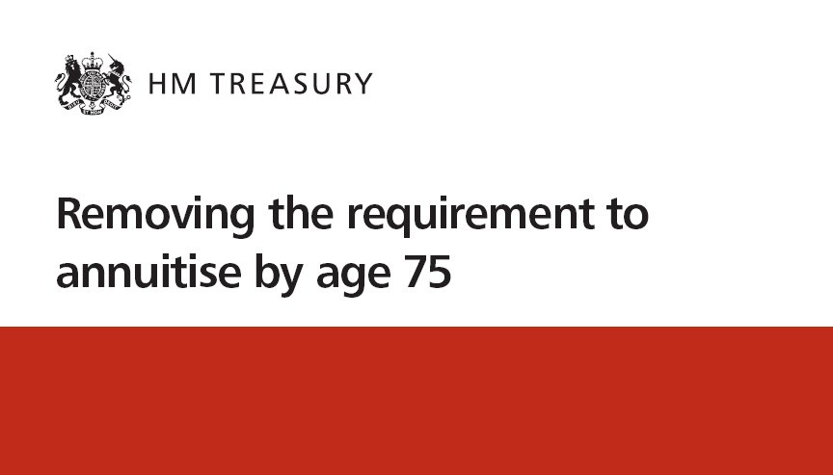
This is where it all started ……..

Slide 195
Pre Age 75
USP v Drawdown pension
Unsecured Pension
Drawdown pension
Availability
55 – 75 (77)
From 55 with no upper age limit
120% of GAD (based on age, gender and gilt yields)
Maximum income
120% of GAD (based on age, gender and gilt yields)
100% of GAD* (based on age, gender and gilt yields)
Minimum income
0% of GAD
0% of GAD
Formal review of income level
5 years
3 years
Tax charge on death
35% of fund
55% of fund
Flexible drawdown
N/A
Available assuming minimum income level is secured
* Awaiting new GAD tables to confirm this

Slide 196
Pre Age 75
ASP v Drawdown pension
Alternatively Secured Pension
Drawdown pension
Availability
At age 75
From 55 with no upper age limit
90% of GAD
(based on 75 and gilt yields)
Maximum income
90% of GAD
(based on 75 and gilt yields)
100% of GAD* (based on age, gender and gilt yields)
Minimum income
55% of GAD (based on 75,gender and gilt yields)
0% of GAD* (based on age, gender and gilt yields)
55% of GAD (based on 75,gender and gilt yields)
Formal review of income level
Annually
Annually
Tax charge on death
82% of fund
55% of fund
Flexible drawdown
N/A
Available assuming minimum income level is secured
Transitional rules
* Awaiting new GAD tables to confirm this

Slide 197
Question
Is your firm going to offer Flexible Drawdown to clients?
A = Yes
B = No
C = Don't Know

Slide 198
Flexible Drawdown
After meeting the MIR, an individual aged 55 or over can opt to move from capped to flexible drawdown if they want more income than 100% GAD.
Dependants with capped drawdown benefits may also opt for flexible drawdown if MIR is satisfied.
Unlimited amounts can be then be drawn down, taxable as income.
No contributions can be made to any money purchase scheme in the tax year in which client first opts for flexible drawdown
Must cease active membership of any DB or cash balance scheme before going into flexible drawdown
Flexible Drawdown from Protected Rights Fund is not permitted.
Once in Flexible Drawdown, clients Annual Allowance reduces to zero

Slide 199
Minimum Income Requirement (MIR)
Purpose of MIR is to ensure that an individual will always have sufficient income to keep them off state benefits.
The income threshold is to be set at £20,000 p.a. – no increases required!
Types of income that will count towards MIR are:
  Scheme pension or dependant’s scheme pension from a registered pension scheme
  Lifetime annuity or dependant’s annuity from a registered pension scheme
  Income from relevant non-UK pension schemes
  Payments of social security benefits – state pension, graduated pension, additional state pension, widow’s pension, widowed parent’s allowance etc or similar payments from a country outside of the UK
PLA and drawdown based income are specifically excluded
Once MIR satisfied there will be no re-testing in subsequent years.
Level of MIR likely to be reviewed every five years.

Slide 200
Which route is the best fit?
 | Master Trust SIPP | Family SIPP | SSAS
Personal Arrangement | Y | Y | N*
No Trustee Duties | Y | Y | N
Individual RPS | N | Y | Y
Include Protected Rights | Y | Y | N
Commercial Property | Y | Y | Y
Borrowing | Y | Y | Y
Loanbacks | N | N | Y
DFMs | Y | Y | Y
Pooling | N | Y | Y
Capped drawdown | Y | Y | Y
Flexible drawdown | Y | Y | Y
Scheme Pension | N | Y | Y
* sponsoring Employer required

Slide 201
Scheme Pension from an individual trust based scheme
Definition:
Must be paid for the life of the member (or dependant)
Must be paid at least annually
Must not be capable of being reduced year on year – except in specific circumstances
“Scheme Pensions are intended to provide a stable and predictable source of pension income for the recipient. However, there are a number of circumstances in which schemes may want to reduce Scheme Pensions quite legitimately.”

Slide 202
Scheme Pension
Member agrees to exchange their interest in the fund in return for an agreement from the scheme to pay a certain pension for life
When can you have it?
  It can be offered at outset when the pension commences
  Following a period of drawdown
  For surviving spouse/dependant
  For a transferred dependant

Slide 203
Level of Scheme Pension
Factors influencing level of scheme pension:
Value of fund
  Life expectancy based on age, gender and health
  Prospective yield – actuarial flexibility minimum to maximum
  Fund performance at reviews
  Charges
  IFA fees
  Other members in Scheme Pension
  Mortality drag
Underwriting not required but is potentially available
Calculated by the Scheme’s Advising Actuary

Slide 204
Scheme Pension
All Scheme Pensions will be actuarially calculated.
A simple approach might be to offer a range of potential scheme pension outcomes:
  Max Scheme pension assumes = 100% equities investment
  Min Scheme pension assumes = 100% cash investment

Slide 205
Income Options
Factors to consider:
Life expectancy
Health
Number of dependants
Income requirements
Death benefit options
Attitude to investment risk
Drawdown v Lifetime Annuity v Scheme Pension
Current and future asset liquidity

Slide 206
Scheme Pension - Risks
Benefits are not guaranteed
Level of scheme pension may need to be reduced
Provision for dependants is not guaranteed
Lack of income flexibility
The effect of inflation

Slide 207
Scheme Pension Summary
Income
A form of “secured” pension
Scheme Pension is calculated by reference to
  the fund size
  the age, gender and life expectancy of the individual and the nature of the investments
Potentially higher income than annuity or Drawdown.
Death Benefits
10 year fixed payment period possible
- Fixed period payments are generally paid free of Inheritance Tax (as paid at Scheme Administrator’s discretion)
Lump sum paid via Annuity Protection.
Dependants pension can be provided from any remaining fund on death
Any left over funds, can be used to pay charges or paid to beneficiaries subject to tax
Notes:
A scheme pension can be set up to provide for a dependants pension in two ways 1) as part of the scheme pension arrangement for the original client at outset i.e. a contingent scheme pension which will reduce the initial level of scheme pension or 2) from any remaining fund, if there is one, on death of the original scheme pension member who had a single life scheme pension. A dependant could also be a beneficiary of a fixed payment period.
NB: AXA only do option 2.

Slide 208
Question
Does your firm offer scheme pensions to clients?
A = Yes – under SSAS only
B = Yes – under SIPP only
C = Yes – under both SSAS and SIPP
D = No
E = Don't know

Slide 209
How much will the MIR cost to secure with a 10 year guarantee/fixed payment period?
Assumptions:
Annuity – single life male, annually in arrears, 10 year guarantee. Scheme pension – single life male, high scheme pension, annually in arrears, 10 year fixed payment period, 1.5% AMC
Source: Annuity rates from Assureweb as at 14.12.2010. Scheme pension rates from AXA Wealth as at 14.12.2010

Slide 210

Capped drawdown fund valued at £1,000,000.
£450,000 lump sum payable on death
Death
Assume fund of £300,000 used to provide MIR
Guarantee / fixed payment period, spouses pension, no benefit payable on death?
Plus
Death
Plus
Flexible drawdown fund £700,000 fully paid as income
£350,000 lump sum assuming income tax at 50%
£210,000 lump sum payable on death
net of IHT @ 40%
Death

Slide 211
How much of the fund will actually be required to provide the MIR?
What death benefits will be payable under any annuity or scheme pension purchased?
What rate of tax will the client pay on lump sums withdrawn from a flexible drawdown?
Will clients consider gifting lump sums taken from a flexible drawdown?

Slide 212
Scheme Pensions and flexible drawdown under one roof!
Typical family SIPP?
Scheme pension fund
£20,000 p.a.
meeting MIR
Flexible drawdown fund
unlimited
income
All part of the same investment strategy!

Slide 213
Question
For those firms that will offer Flexible Drawdown, what percentage of customers will have sufficient funds to make it viable??
A = 0 – 5%
B = 5 – 10%
C = 10 – 25%
D = above 25%
E = Don't Know

Slide 214
Question
Do you believe that a scheme pension from a SSAS or SIPP is a viable method of securing the MIR?
A = Yes
B = No
C = Don't Know

Slide 215
Important information
Information regarding tax and practice is based on AXA Wealth’s understanding of current legislation and HM Revenue & Customs policy/practice. Tax treatment is subject to change and individual circumstances.
The information contained in this presentation does not constitute advice. It is designed for financial adviser use only and is not intended for use with individual investors. Any sample screen shots displayed are correct at date of issue but may be subject to change.
AXA Wealth, Winterthur Way, Basingstoke, Hampshire, RG21 6SZ. Telephone number: 01256 470707. As part of our commitment to quality service, telephone calls may be recorded.
Architas Multi-Manager Limited (No. 06458717), AXA Portfolio Services Limited (No. 1128611), AXA Wealth Services Limited (No. 02238458), Winterthur Life UK Limited (No. 3116645) and AXA Wealth Limited (No. 01225468) are all companies registered in England and limited by shares. Their registered office is 5 Old Broad Street, London, EC2 1AD. Each company promotes and distributes its own products and is authorised and regulated by the Financial Services Authority. AXA Wealth Services Limited also promotes and distributes the products of AXA Isle of Man Limited and AXA Life Europe Limited in the United Kingdom.
AXA Wealth is a marketing brand used by these companies. Details of the companies offering specific products are contained within product literature.
Notes:
215

Slide 216
Robert Graves
Rowanmoor Pensions
Final Open Session

Slide 217
Andrew Roberts
Barnett Waddingham LLP
Chairmans Close and End

Slide 218
Chairman's Close
Thanks to:
the speakers
the A/V team
the event organiser Claire May, and
to you all for your participation.
SAFE JOURNEY!

