Slide 1
Retirement Outcomes Review: Consultation Paper 19/5
Roundtable with AMPS, 20 March 2019
Bianca Garwood, Richard Wilson, Adam Summerfield, Susan Cooper

Slide 2
Discussion Structure
14:00 | Intros
14:05 | Chapter 5 - Investment pathways: the consumers and providers our requirements will apply to
14:20 | Chapter 6 - Investment pathways: the choices that providers must offer consumers
14:35 | Chapter 7 - Investment pathways: our requirements for providers on the pathways solutions
14:50 | Chapter 8 - Investment pathways: other key elements of our proposals
15:00 | Chapter 9 - Ensuring investment in cash is an active decision
15:10 | Chapter 10 – Actual Charges Information
15:25 | Next Steps

Slide 3
Chapter 5 - Investment pathways: the consumers and providers our requirements will apply to
Consumers covered – non-advised consumers
Triggers for offering pathways
Staged drawdown
All pension providers covered
Q1 Do you agree with our proposed rules on when a consumer must be offered investment pathways, including how consumers who enter drawdown in stages should be treated, and that those who take an UFPLS are not included?
Q2 Do you agree with our proposal that all providers of drawdown to non‑advised consumers should be covered by our requirements on investment pathways, including SIPP operators?

Slide 4
Chapter 6 - Investment pathways: the choices that providers must offer consumers
The 4 objectives proposed:
  Option 1: I have no plans to touch my money in the next 5 years
  Option 2: I plan to use my money to set up a guaranteed income (annuity) within the next 5 years
  Option 3: I plan to start taking my money as a long‑term income within the next 5 years
  Option 4: I plan to take out all my money within the next 5 years
  Q3 Do you agree with our proposed 4 objectives, and mandating all providers to use our prescribed wording when presenting these objectives?
  Q4 Do you agree that providers should only be able to offer 1 pathway solution for each investment pathway objective?
  Q5 Do you agree with our proposed rule requirements for the choice architecture, and do you agree that providers can offer investment pathways without giving the consumer a personal recommendation?

Slide 5
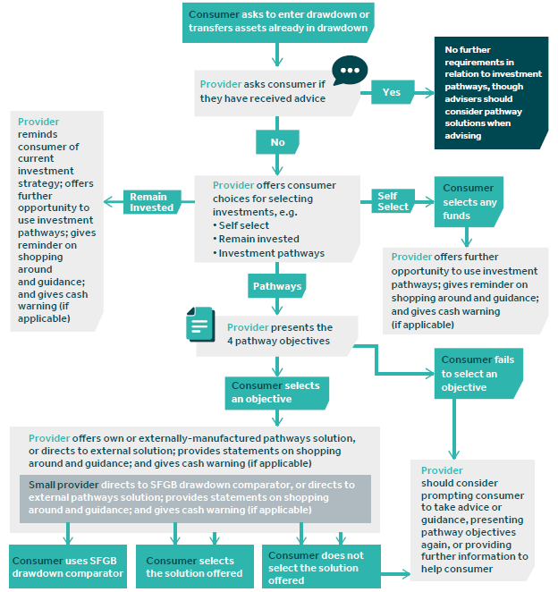
Chapter 6 - Flow chart
Notes:
This looks complicated…
But actually, we don’t believe it is. I don’t propose to talk through this in detail now – but do pick up with me later if you have any questions. The graphic can be found in CP19/5.
One point that’s worth raising is that our work in the ROR suggested that structured offerings are important to enabling non-advised consumers to select investments that are appropriate for their needs and objectives. Our approach to the structure of offerings - which we describe in the document as ‘choice architecture’ – is flexible enough to allow consumers to easily adapt their existing drawdown consumer journey, but has clear requirements in place to ensure that investment pathways take a prominent position in the consumer journey.

Slide 6
Chapter 7 - Investment pathways: our requirements for providers on the pathways solutions
Q6 Do you agree with our proposed rule to prevent providers from offering the same pathways solution for all the objectives?
Q7 Do you agree with our proposed rules on labelling of pathways solutions?
Q8 Do you agree with our proposed rules requiring larger providers to provide pathways solutions for at least 2 of the 4 objectives and to refer consumers to another provider’s pathways solutions for any objectives where they don’t provide a pathways solution?
Q9 Do you agree with our proposed easement for smaller providers, including our proposals for the operation and level of the threshold for qualifying for this easement?

Slide 7
Chapter 8 - Investment pathways: other key elements of our proposals
Q10 Do you agree with our proposed approach to product governance for firms manufacturing pathways solutions used to provide investment pathways? Do you agree with our proposed approach for distributors?
Q11 Do you agree with our proposed approach for ongoing information to consumers using investment pathways? Do we go far enough, or is there anything further that providers could do to ensure that consumers carefully consider their investment choice on a periodic basis?
Q12 Do you agree with our proposed approach for the records providers should keep?
Q13 Do you agree with our implementation timeline?

Slide 8
Chapter 9 - Ensuring investment in cash is an active decision
Q14 Do you agree with our proposals to ensure cash investment is an active choice?
Q15 Do you agree with our proposals on the warning about investment in cash that the non‑advised consumer will get when they enter drawdown or transfer‑in funds in drawdown to a new provider?
Q16 Do you agree with our proposals on the ongoing warning around investment in cash? If no, what would you suggest?
Q17 Do you agree with our proposed approach for the records providers should keep?
Q18 Do you agree with our implementation timeline? In particular, do you agree with our view that these remedies should be implemented at the same time as investment pathways?

Slide 9
Chapter 10 – Actual Charges Information
Q19 Do you agree that, in relation to their decumulation pensions, unless charges are built into the disclosed price of the product, consumers should receive information at least annually on all the actual charges they have paid, aggregated and expressed as a cash amount?
Q20 Do you agree that our rules should require disclosure of transaction costs, but not specify how transaction costs should be calculated?
Q21 Do you agree that firms should disclose the adviser charges paid out of the product, or clarify that adviser charges are not included in the annual pension charges figure they disclose?
Q22 Do you agree with our implementation timeline?

Slide 10
Next steps – timeline
28 January 2019 | Policy Statement (PS19/1) and Consultation Paper (CP19/5) published
4 April 2019 | Consultation on CP19/5 closes
April-June 2019 | Consideration of responses to CP19/5; development and internal sign-off of final rules for July PS
July 2019 | Second Policy Statement published with final version of rules consulted on in CP19/5
1 November 2019 | PS19/1: Changes to rules on wake-up packs and annuity information prompt come into force
6 April 2020 | PS19/1: Changes to rules on Key Features Illustrations and annual communications come into force
July 2020 | Proposed implementation date for rules consulted on in CP19/5
From July 2021 | Potential start of Post Implementation Review of Investment Pathways

